Slide 1
Introductory General Chemistry
Chemistry 3A
Experiment 6a
Molecular Modeling
Mitch Halloran

Slide 2
Introduction
Molecules which include polyatomic ions can be represented with Lewis structures and ball-and-stick models
A difference between Lewis structures and the ball-and-stick models is that latter can show molecular geometry
This experiment will
  Use ball and stick to represent molecules three-dimensionally
  Use electron dot Lewis structures to represent molecules two-dimensionally

Slide 3
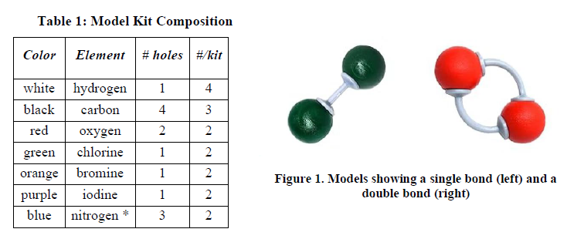
Background
Model kits will build molecules in 3-D with balls of different colors for different atoms, and gray connectors
  Single bonds have short, rigid connectors
  Double & triple bonds have longer flexible connectors

Slide 4

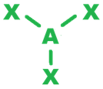

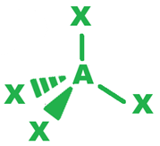


Shape Summary
# of Electron Groups | Electron Group Symmetry | Ideal Bond Angle | Molecular Geometry
 |  |  | 0 lone pairs | 1 lone pair | 2 lone pairs
2 | Linear | 180° | Linear
3 | Trigonal Planar | 120° | Trigonal Planar | Bent
4 | Tetrahedral | 109.5° | Tetrahedral | Trigonal Pyramidal | Bent

Slide 5
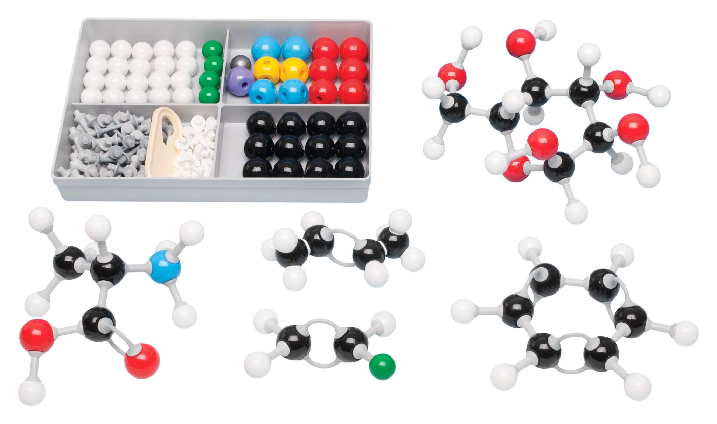

Equipment You Will Use

Slide 6
Important Notes
This lab report has EIGHT (8) PAGES. So you are to take 8 images and put them in 1 PDF for your report
For every Molecular Model Sketch, you are to construct the model using the kit pieces. You are then to sketch what you see!!
Read the title at the top of the page!
“Molecular models with single bonds only”…”with one double bond, with

Slide 7
Procedure
Drawing Lewis Structures First
A table with 10 rows representing 10 different molecules will have the Lewis structure drawn first in the lab report
Using the molecular model kit, use the correct colored ball and connectors to construct what Lewis structure shows
Use colored pencils to sketch the model and color it in in lab report
Count electron groups and indicate the geometry of electron groups and molecule. Use appropriate terms to indicate geometry

Slide 8
Procedure
Constructing Molecular Models First
A table with 8 rows representing 8 different molecules requires the construction of molecules using modeling kit
Complete the lab report with a sketch of molecule from kit components, indicate valence electrons, draw Lewis dot structure
Indicate number of electron groups, the geometry of electron groups, and geometry of molecule

Slide 9
Procedure
Unknown Molecules
Models of five molecules will be presented
For each, there are entries to be made in the lab report as follows:
  Sketch the model with colored pencils
  Determine valence electrons
  Draw the Lewis structure
  Enter the chemical formula in the 1st column

Slide 10
Clean Up
Return parts to modeling kits
Organize colored pencils back in storage containers

Slide 11
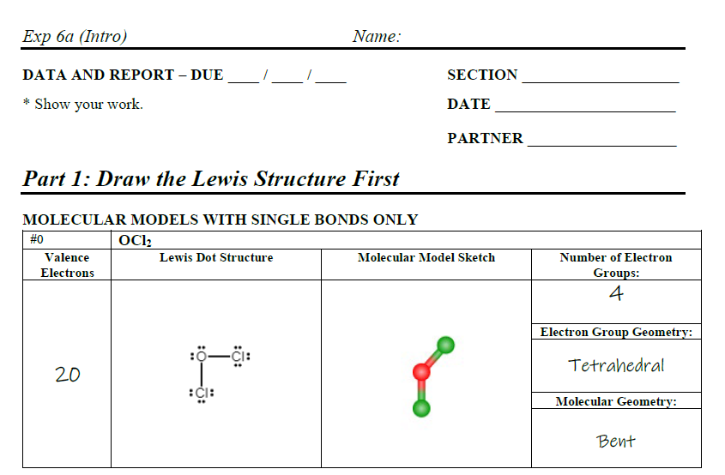
Although you could probably do this report (online and handwritten) even before coming to lab or not even coming at all, you must attend lab, note your partner’s name, and stay until the Attendance Code is given.
No one is allowed to submit a report (MOM or handwritten) if their attendance is not recorded
NOTE: the unknowns I build will NOT necessarily be the same as from previous semesters, another reason to attend!

Slide 12
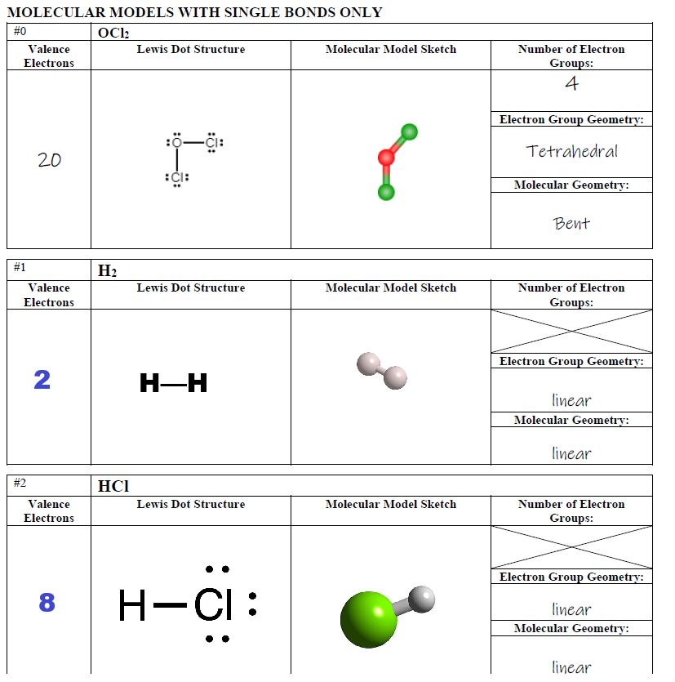

Slide 13
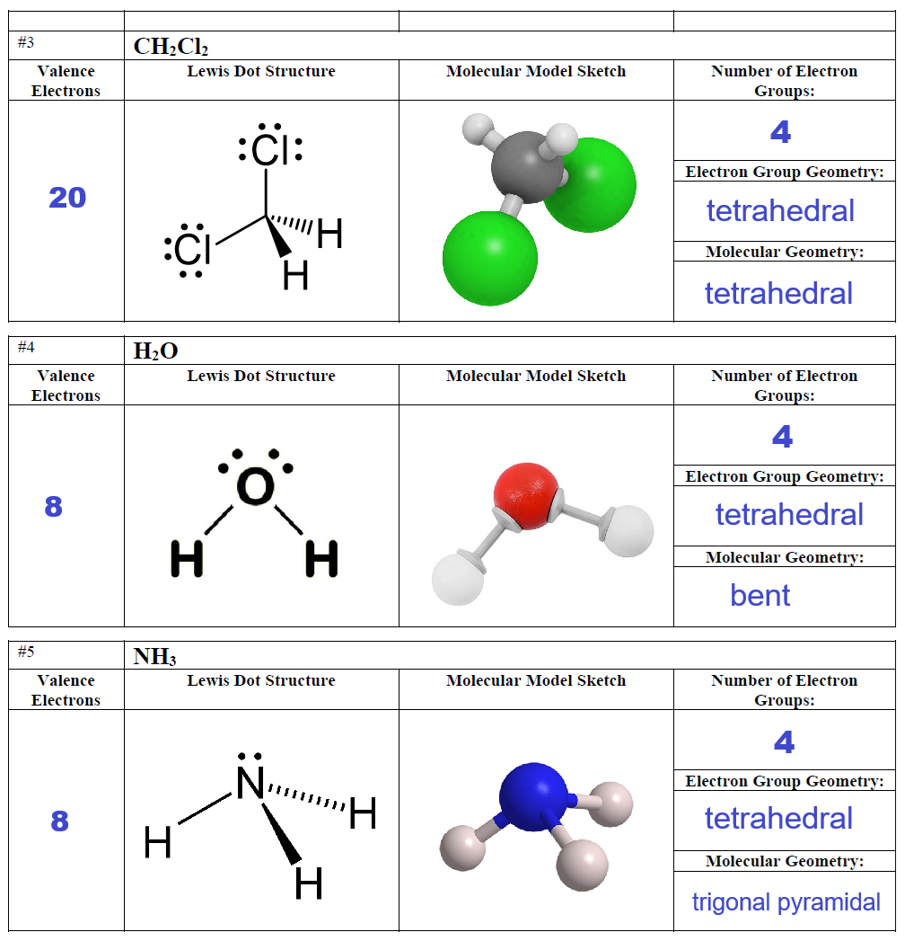

Slide 14
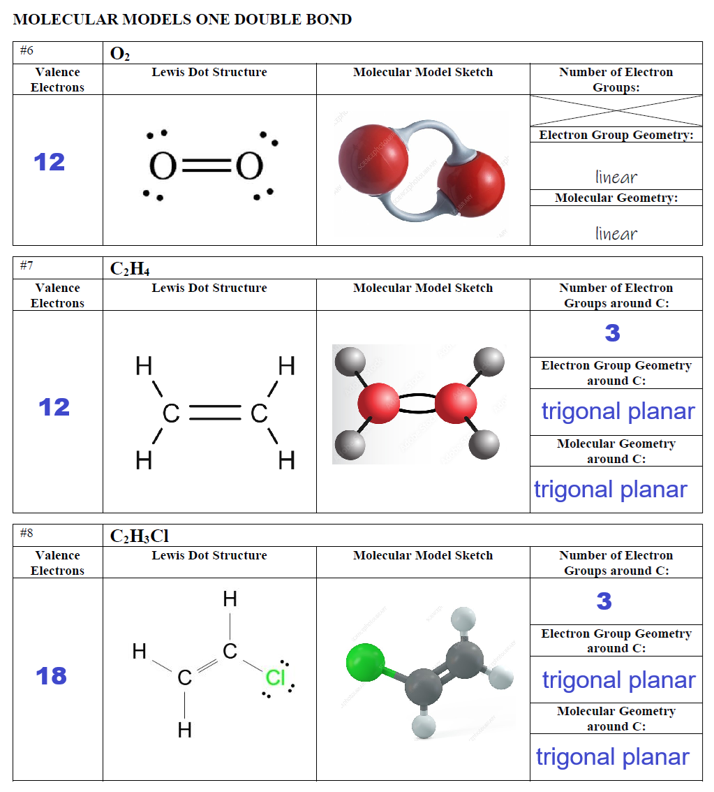

Slide 15
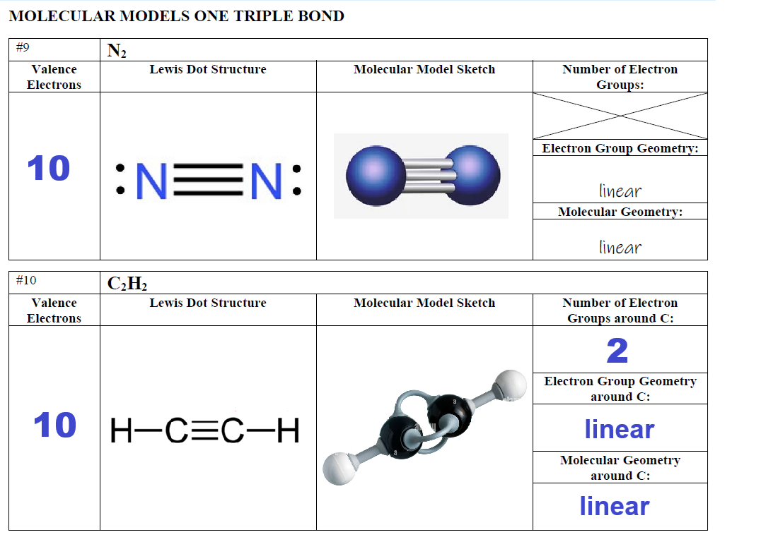

Slide 16
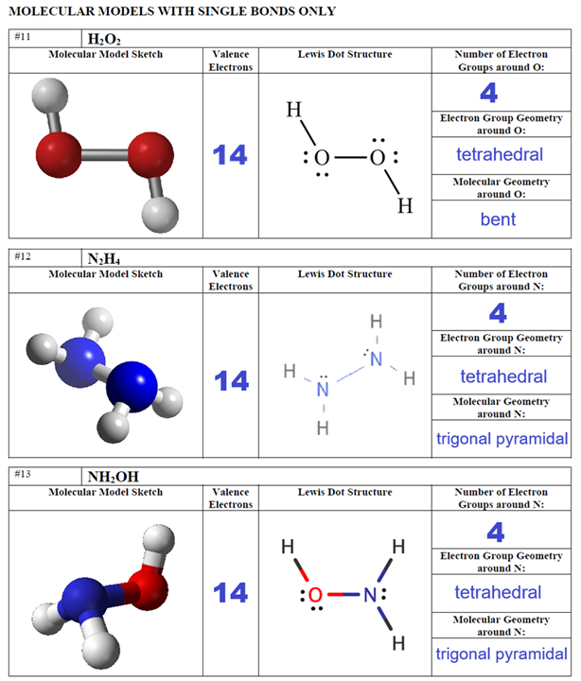

Slide 17
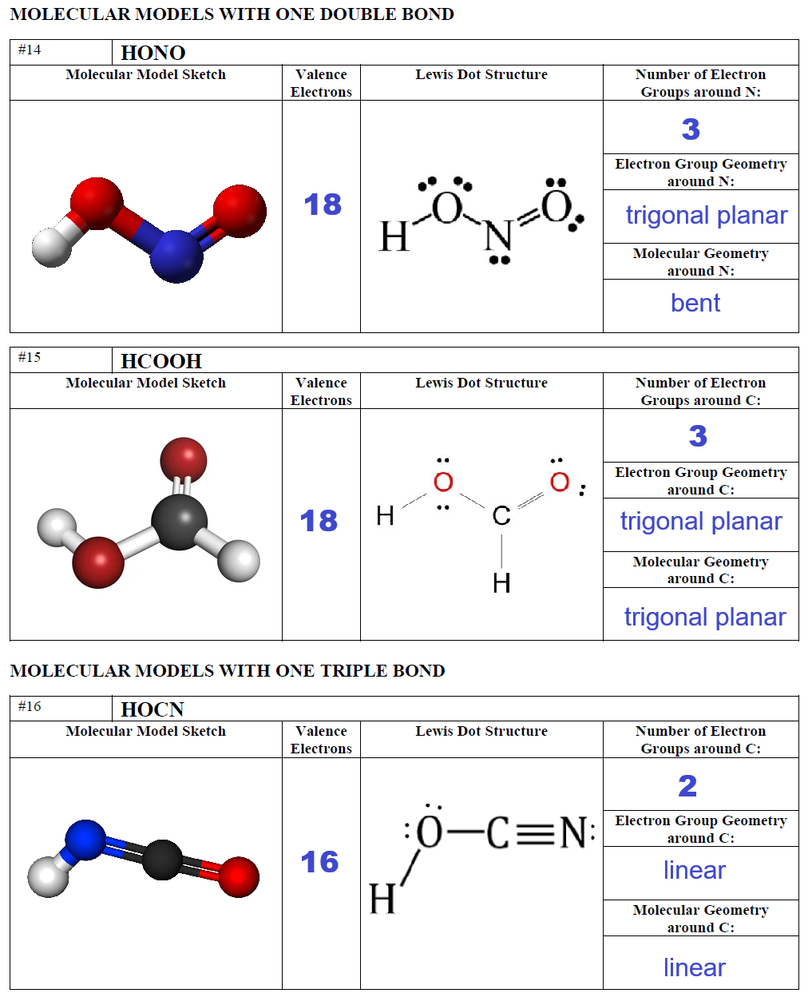

Slide 18
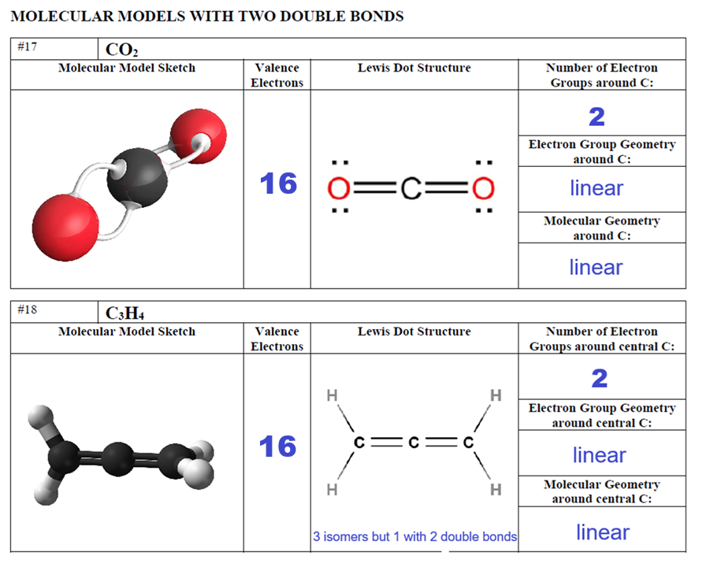

Slide 19
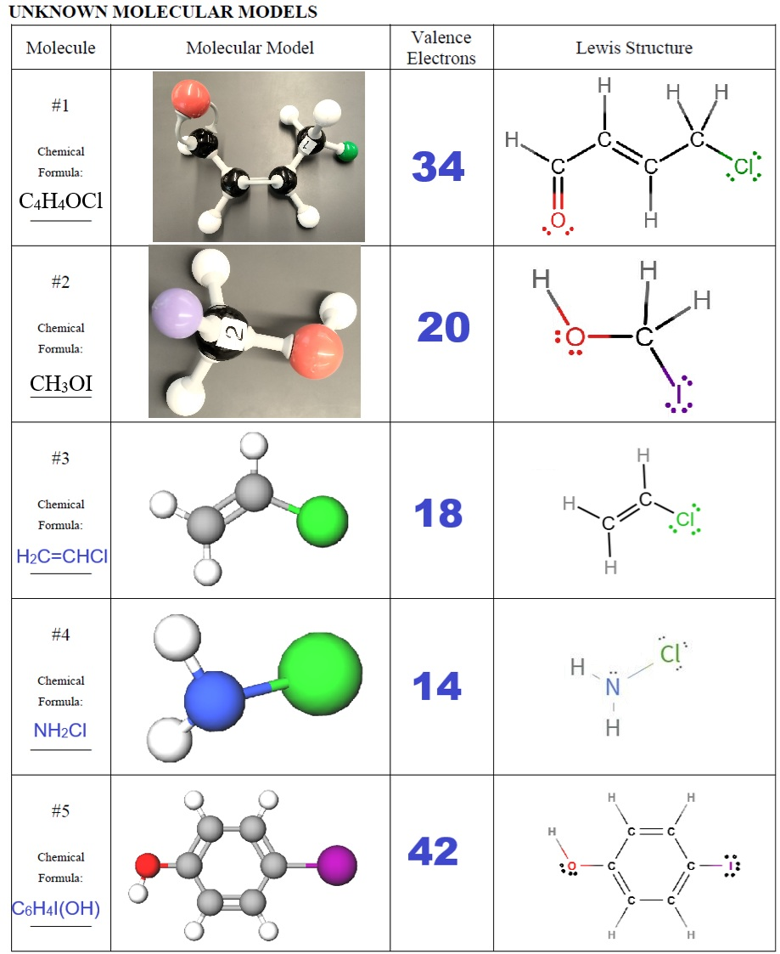

Slide 20


